Slide 1

P_update
Format: b0 v0 chi_max
Need to see collapse of dilute layer to get sharp decrease

Slide 2




Corrected
Previous

Slide 3

Incorrect

Slide 4

Corrected - 20220722

Slide 5
Initial sweep
b10, b15, b20; chi 2.6
v0 = x b^3 (b/d ratio)

Slide 6

Using excluded volume from Rubinstein Ch 3.1
Start with b = 0.5, 1.0, 1.5, 2.0, 5.0 nm
V0 = b^3 (spherical) (max flexible)
b^2 * d (cylindrical)
New options (09/03 code)
V0 = 4/3*pi*b^3 (b/d = 0.2387…) (Max flexible)
V1 = 1.00*b^3 (b/d = 1.0)
V2 = 0.50*b^3 (b/d = 2.0) (Rubinstein “flexible”)
V3 = 0.33*b^3 (b/d = 3.0) (Rubinstein “flexible”)
V4 = 0.15*b^3 (b/d = 6.5)
Rubinstein, pdf pg 108: b/d 2~3 for flexible,
PE, PEO: d = 0.8 nm
PS: d = 0.5 nm

Slide 7





b10 – thresh = 1e-04

Slide 8





b10 – maxpoint Gibbs

Slide 9





b10 – first moment Gibbs

Slide 10





b10

Slide 11





B15 – thresh = 1e-04

Slide 12





b15 - maxpt

Slide 13





b15 - norm

Slide 14





b15

Slide 15





b20 – thresh = 1e-04

Slide 16





b20 - maxpt

Slide 17





b20 - norm

Slide 18





b20

Slide 19
V perturb
Around b10 v2 and b20 v4 (~%20)

Slide 20






-20%: v=0.4
Orig: b=1.0, v=0.5
+20%: v=0.6

Slide 21



-20%: v=0.4
Orig: b=1.0, v=0.5
+20%: v=0.6

Slide 22






-20%: v=1.0
Orig: b=2.0, v=1.2
+20%: v=1.4

Slide 23


-20%: v=1.0
Orig: b=2.0, v=1.2
+20%: v=1.4

Slide 24
Chi perturb
Around b10 v2 and b20 v4 (~%20)

Slide 25









c4
Orig: b=1.0, v=0.5, chi = 2.6
c8
c0

Slide 26



c4
Orig: b=1.0, v=0.5, chi = 2.6
c8
c0

Slide 27









c4
Orig: b=2.0, v=1.2, chi = 2.6
c8
c0

Slide 28



c4
Orig: b=2.0, v=1.2, chi = 2.6
c8
c0

Slide 29
Fine adjust

Slide 30






b1.0 v0.51 c6
b1.0 v0.52 c6
b=1.0, v=0.50, chi = 2.4, 2.6, 2.8

Slide 31




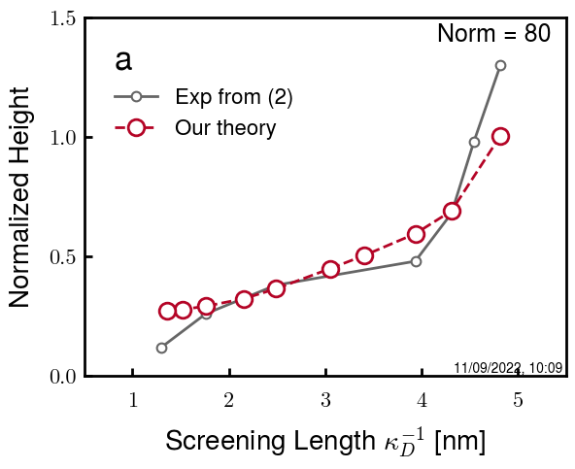
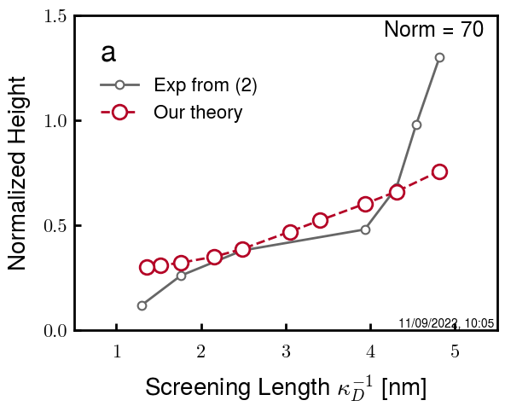
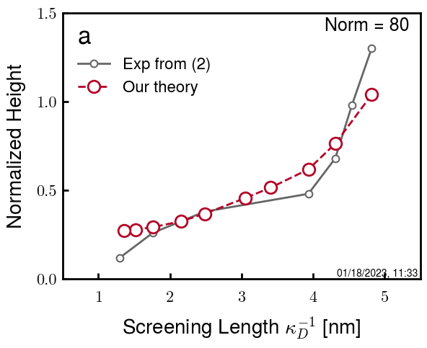
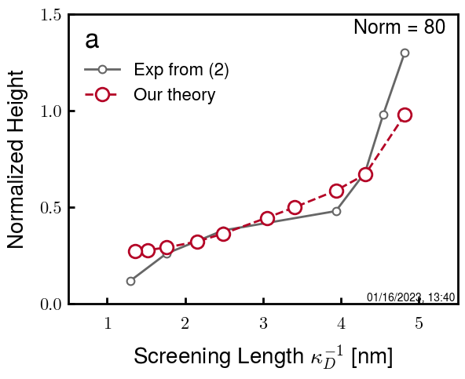
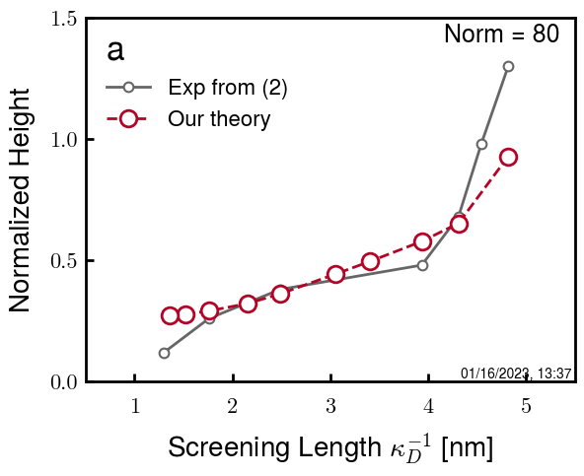
b=2.0, v=1.20, chi = 2.4, 2.6, 2.8
b2.0 v1.20 c8
b2.0 v1.21 c8
b2.1 v1.20 c8
b2.2 v1.22 c8
b2.2 v1.22 c0
b2.2 v1.22 c1
b2.2 v1.22 c2
b2.2 v1.20 c1
b2.2 v1.22 c1
b2.2 v1.23 c1
b2.2 v1.24 c1
B2.2 v1.20 c3.05
(f205)

Slide 32
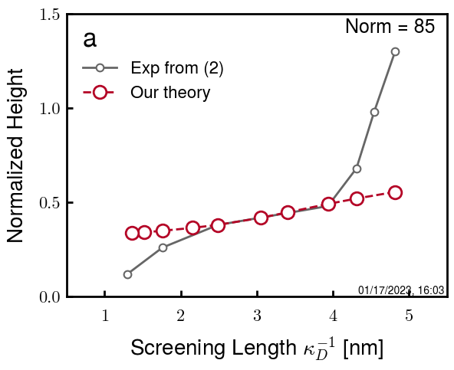
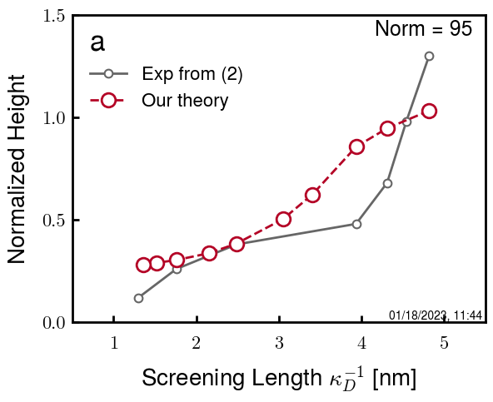

b2.5 v1.25 c3.10
b2.5 v1.25 c3.15
b2.5 v1.25 c3.20
7,9,10

Slide 33
Summary

Slide 34
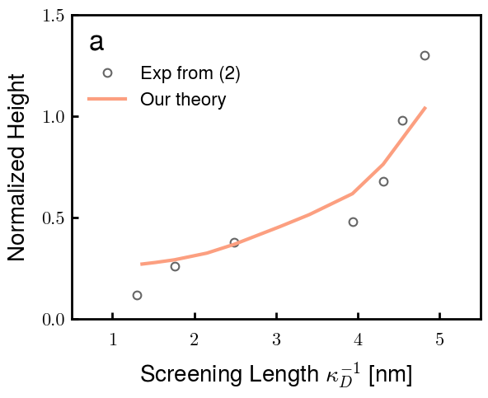
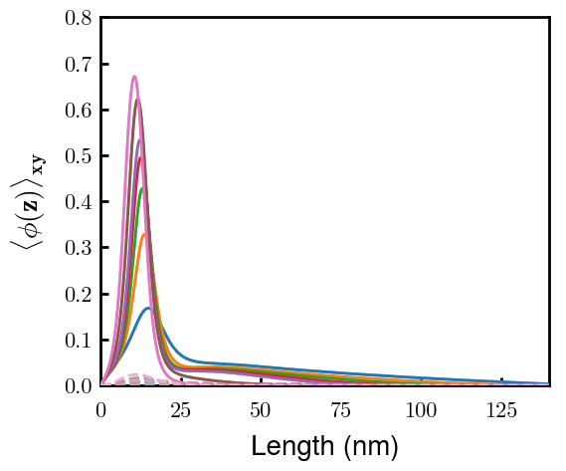
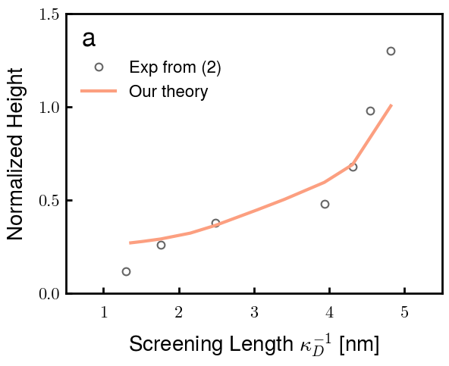
Best so far:
b2.2 v1.20 c3.10 (f201)
b2.2 v1.22 c3.10 (b2v2c1)

Slide 35
PREV

Slide 36






06 04 260
06 04 240
06 04 220
07 04 260
07 04 240
07 04 220

Slide 37






08 04 260
08 04 240
08 04 220
09 04 260
09 04 240
09 04 220

Slide 38
10 04 260
10 04 240
10 04 220
All stretched longer than given box size (150*0.6 = 90)

Slide 39






04 03 260
04 03 240
04 03 220
05 03 260
05 03 240
05 03 220

Slide 40






06 03 260
06 03 240
06 03 220
07 03 260
07 03 240
07 03 220

Slide 41





04 05 260
04 05 240
04 05 220
05 05 260
05 05 240
05 05 220

Slide 42






06 05 260
06 05 240
06 05 220
07 05 260
07 05 240
07 05 220

Slide 43




04 06 260
04 06 240
04 06 220
05 06 260
05 06 240
05 06 220

Slide 44






06 06 260
06 06 240
06 06 220
07 06 260
07 06 240
07 06 220

Slide 45



05 07 260
05 07 240
05 07 220
06 07 260
06 07 240
06 07 220

Slide 46



07 07 260
07 07 240
07 07 220
08 07 260
08 07 240
08 07 220

Slide 47
06 09 260
06 09 240
06 09 220
07 09 260
07 09 240
07 09 220

Slide 48





08 09 260
08 09 240
08 09 220
09 09 260
09 09 240
09 09 220

Slide 49



10 09 260
10 09 240
10 09 220

Slide 50






1.0 1.0 2.6
1.0 1.0 2.8
1.0 1.0 3.0
1.2 1.0 2.6
1.2 1.0 2.8
1.2 1.0 3.0

Slide 51




1.4 1.0 2.6
1.4 1.0 2.8
1.4 1.0 3.0
1.0 1.2 2.6
1.0 1.2 2.8
1.0 1.2 3.0

Slide 52




1.2 1.2 2.6
1.2 1.2 2.8
1.2 1.2 3.0
1.4 1.2 2.6
1.4 1.2 2.8
1.4 1.2 3.0

Slide 53






1.0 1.4 2.6
1.0 1.4 2.8
1.0 1.4 3.0
1.2 1.4 2.6
1.2 1.4 2.8
1.2 1.4 3.0

Slide 54

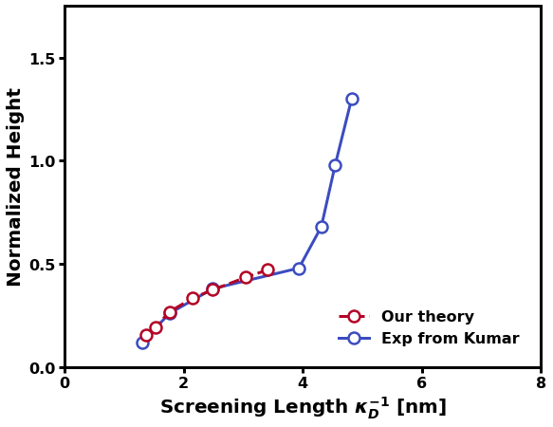

1.4 1.4 2.6
1.4 1.4 2.8
1.4 1.4 3.0

